Slide 1
An Update on KASPER
Jill E. Lee
Investigator
Drug Enforcement and Professional Practices Branch
Kentucky Cabinet for Health and Family Services
Kentucky Rural Health Association
September 27, 2013

Slide 2
Disclosure
Jill E. Lee
No relevant financial relationships.
No conflicts of interest.

Slide 3
Contents
Operation and Status of KASPER
The Drug Enforcement and Professional Practices Branch
Legislative Changes Affecting Controlled Substance Prescribing in Kentucky

Slide 4
An Update on the KASPER Program

Slide 5
KASPER
KASPER is Kentucky’s Prescription Monitoring Program (PMP). KASPER tracks Schedule II – V controlled substance prescriptions dispensed within the state as reported by pharmacies and other dispensers.
Enhanced KASPER (eKASPER) is the real-time web accessed database that provides a tool to help address the misuse, abuse and diversion of controlled pharmaceutical substances.

Slide 6
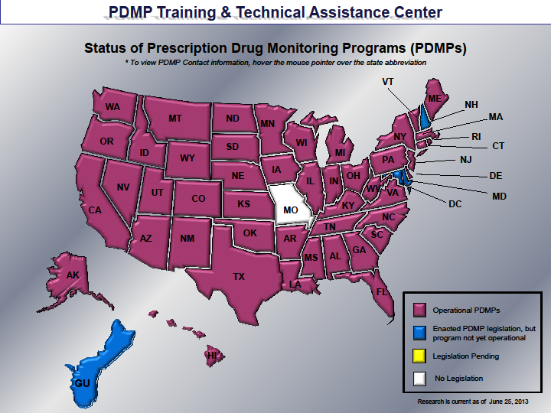
Status of Prescription Drug Monitoring Programs (PDMPs)
VT
WA
ME
MT
ND
MN
NH MA RI CT NJ DE MD
DC
OR
WI
NY
ID
SD
MI
WY
PA
NE
IA
OH
NV
IL
IN
WV
UT
CO
VA
CA
KS
MO
KY
NC
OK
TN
SC
AZ
NM
AR
MS
AL
GA
TX
AK
LA
FL
Operational PDMPs
Enacted PDMP legislation, but
program not yet operational
Legislation pending
HI
GU
Research is current as of February 1, 2012

Slide 7
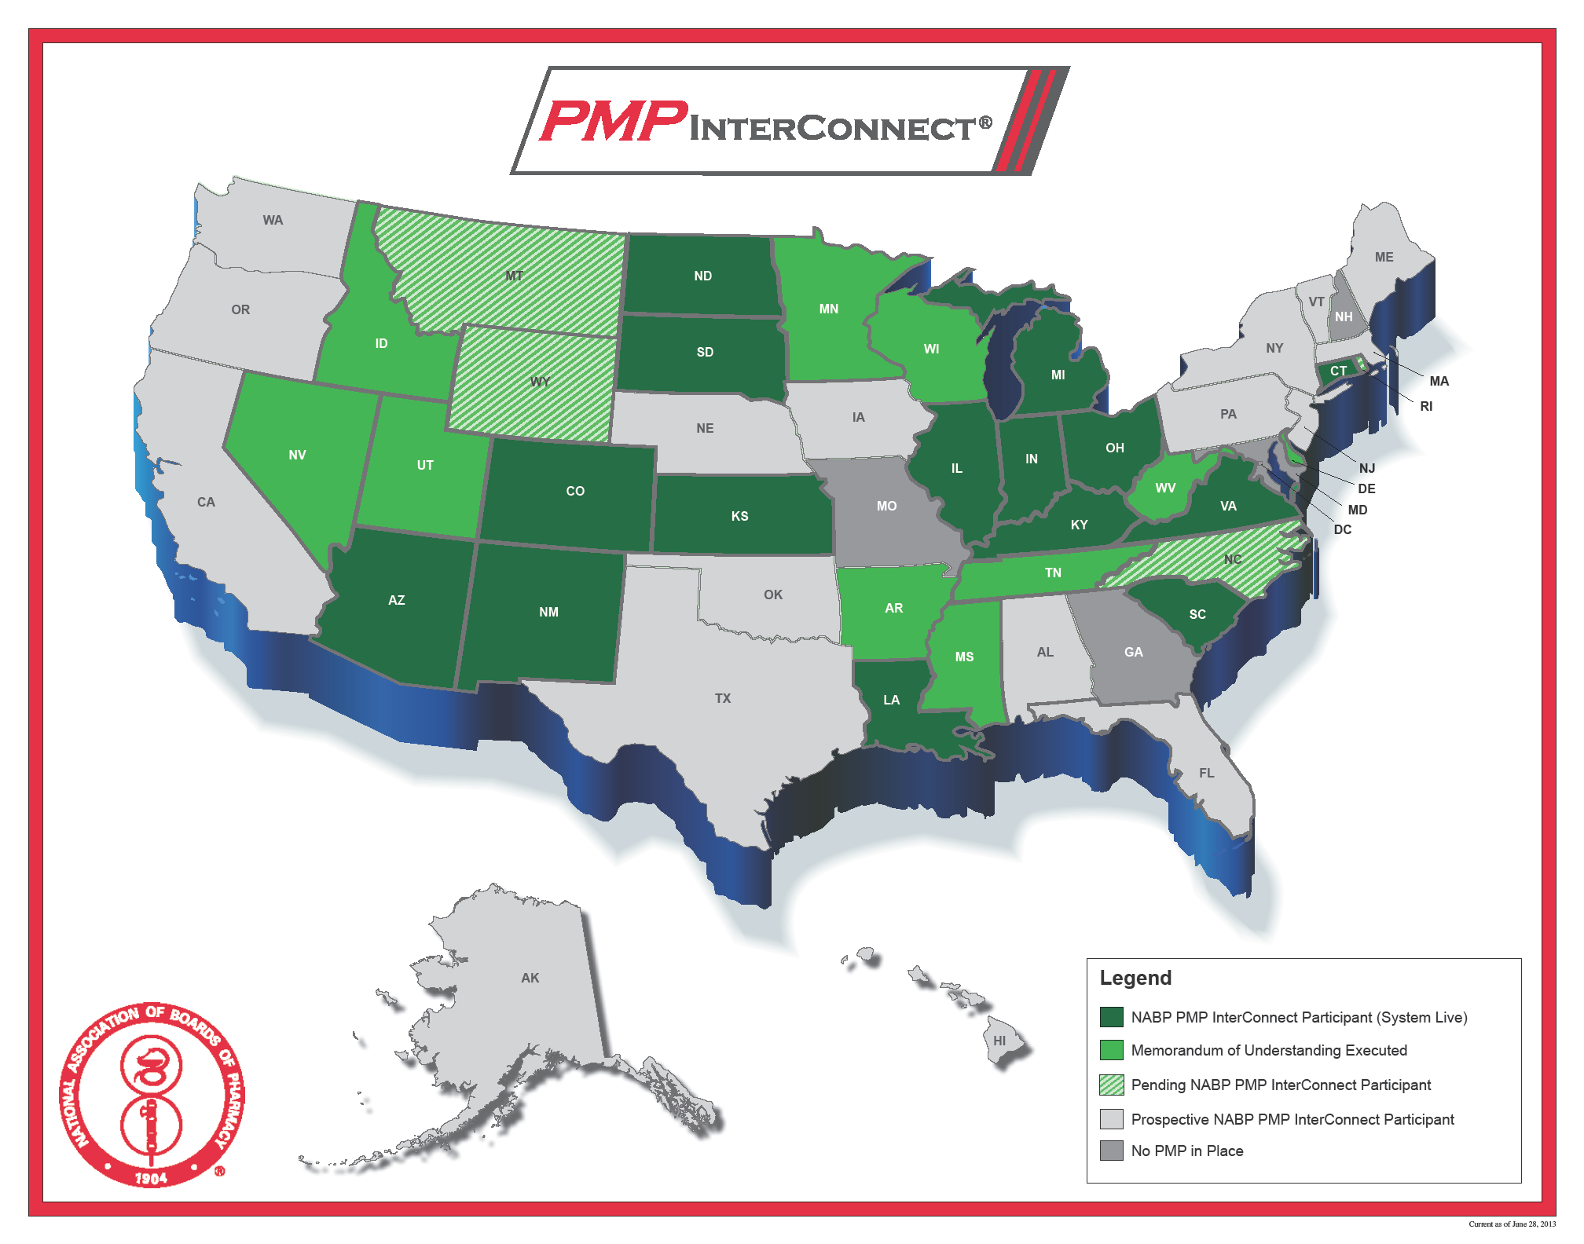
2011 KASPER Reports Requested

Slide 8
KASPER Operation
KASPER tracks most Schedule II – V substances dispensed in KY.
Over 11 million controlled substance prescriptions reported to the system each year.
KASPER data is 1 to 3 days old.
Dispensers have 1 business day to report.
Reports available to authorized individuals.
Available via web typically within 15 seconds (93% of requests).
Available 24/7 from any PC with Web access.

Slide 9
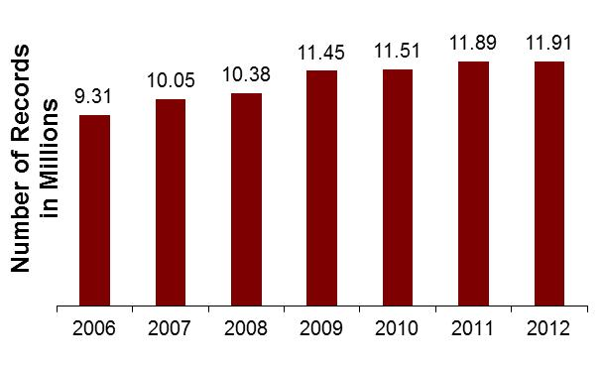
Annual KASPER Records Total / Per Person
2.21 2.39 2.43 2.65 2.65 2.72 2.72
Number of Controlled Substance Prescriptions per Person

Slide 10
2012 KASPER Reports Requested

Slide 11
Top Prescribed Controlled Substances by Therapeutic Category by Doses - 2012
Lorazepam 4.0%
Ativan
Zolpidem 3.5%
Ambien
Amphetamine 2.7%
Adderall
Phentermine 2.4%
Adipex-P
Hydrocodone 41.5% Lortab
Lorcet
Vicodin
Diazepam 4.5%
Valium
Clonazepam 6.6%
Klonopin
Tramadol 6.9%
Ultram
Alprazolam 11.8%
Xanax
Oxycodone 15.9% OxyContin
Percodan
Percocet

Slide 12
KASPER Stakeholders
Licensing Boards – to investigate potential inappropriate prescribing by a licensee.
Practitioners and Pharmacists – to review a current patient’s controlled substance prescription history for medical and/or pharmaceutical treatment.
Law Enforcement Officers, OIG employees, Commonwealth’s attorneys, county attorneys - to review an individual’s controlled substance prescription history as part of a bona fide drug investigation or drug prosecution.
Medicaid – to screen members for potential abuse of pharmacy benefits and to determine “lock-in”; to screen providers for adherence to prescribing guidelines for Medicaid patients.
A judge or probation or parole officer – to help ensure adherence to drug diversion or probation program guidelines.

Slide 13
KASPER Usage December 31, 2012
Pharmacists = 2.1%
Law Enforcement = .5%
Judges, Other
= .1%
Prescribers = 97.3%

Slide 14
Goals of KASPER
KASPER was designed as a tool to help address prescription drug abuse and diversion by providing:
A source of information for health care professionals
An investigative tool for law enforcement and regulatory agencies
KASPER was not designed to:
Prevent people from obtaining prescription drugs
Decrease the number of doses dispensed

Slide 15
The Drug Enforcement and Professional Practices Branch

Slide 16
Drug Enforcement Branch
The Drug Enforcement and Professional Practices Branch (DEPPB) is housed within the Cabinet for Health and Family Services:
Office of Inspector General (OIG)
Division of Audits and Investigations
DEPPB Responsibilities:
Enforcement of Kentucky Controlled Substances Act (KRS 218).
Conducting drug investigations.
Licensing drug manufacturers and distributors.
Enforcement of Kentucky Food, Drug and Cosmetic Act (KRS 217).
Operation of the KASPER program.
Notes:
Introduce Zach

Slide 17
DEPPB Investigators
Over the years DEPPB has migrated from a purely law enforcement agency to a consulting and assistance role in supporting investigations by other law enforcement agencies.
Our investigators, by statute are all pharmacists thereby giving them a unique insight into drugs, provider and dispenser office procedures and record keeping/analysis.

Slide 18
Diversion
What do you do when diversion is suspected?
If you suspect an individual is involved in diverting controlled substances, we ask that you please report them to the proper law enforcement authorities.
If unsure who to contact please call the Drug Enforcement and Professional Practices Branch of the Office of the Inspector General for assistance.
(502) 564-7985
http://www.chfs.ky.gov/os/oig/auditsinv.htm

Slide 19
Diversion
Reporting Provider Shoppers/Diverters
KRS 218A.280 Controlled substances – Communications with practitioner not privileged.
Information communicated to a practitioner in an effort unlawfully to procure a controlled substance, or unlawfully to procure the administration of any controlled substance, shall not be deemed a privileged communication.

Slide 20
Diversion – 902 KAR 55:110
Reporting Provider Shoppers/Diverters
902 KAR 55:110 Section 10 (4) (b): In addition to the purposes authorized under KRS 218A.202(8)(e), and pursuant to KRS 218A.205(2)(a) and (6), a practitioner or pharmacist who obtains KASPER data or a report under KRS 218A.202(6)(e)1. or who in good faith believes that any person, including a patient, has violated the law in attempting to obtain a prescription for a controlled substance, may report suspected improper or illegal use of a controlled substance to law enforcement or the appropriate licensing board.

Slide 21
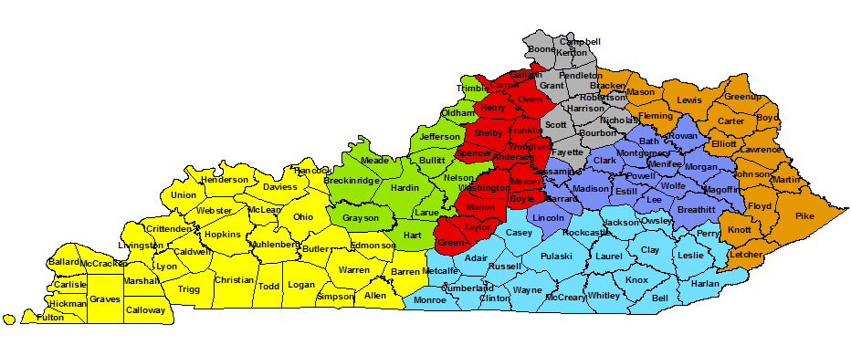
Drug Enforcement and Professional Practices Branch
DEPPB Phone Number: 502-564-7985
Paula York
Jill Lee
Amanda Ward
Carrie Gentry
Laura Beth Wells
Duncan McCracken
Chris Johnson

Slide 22
Controlled Substance Prescribing in Kentucky Recent Legislative Changes

Slide 23
eKASPER Reporting KRS 218A.202
Controlled substance administration or dispensing must be reported within one day effective July 1, 2013

Slide 24
eKASPER Reporting - KRS 218A.202
For Hospitals:
Schedule II controlled substances and Schedule III controlled substances that contain hydrocodone dispensed to a patient
Effective July 1, 2013
Other controlled substances are not required to be reported to KASPER if dispensing a 48 hour or less supply

Slide 25
eKASPER Accounts – KRS 218A.202
eKASPER registration is mandatory for Kentucky practitioners or pharmacists authorized to prescribe or dispense controlled substances to humans.

Slide 26
eKASPER Master Accounts
 | 12/31/2011 | 04/24/2012 | 07/20/2012 | 07/31/2013
Doctor* | 5,470 | 5,680 | 11,923 | 17,296
APRN | 690 | 781 | 1,523 | 2,008
Pharmacist | 1,385 | 1,450 | 3,602 | 5,205
Total | 7,545 | 7,911 | 17,048 | 24,509
*Includes physicians, dentists, optometrists and podiatrists

Slide 27
eKASPER Prescriber Usage - KRS 218A.172
Query eKASPER for previous 12 months of data:
Prior to initial prescribing or dispensing of a Schedule II controlled substance, or a Schedule III controlled substance containing hydrocodone
No less than every three months
Review data before issuing a new prescription or refills for a Schedule II controlled substance or a Schedule III controlled substance containing hydrocodone
Additional rules/exceptions included in licensure board regulations

Slide 28
KASPER Regulations – Licensure Boards
201 KAR 5:130
Kentucky Board of Optometric Examiners KASPER requirements
201 KAR 8:540
Kentucky Board of Dentistry KASPER requirements
201 KAR 9:230, 201 KAR 9:260
Kentucky Board of Medical Licensure KASPER requirements
201 KAR 20:057
Kentucky Board of Nursing KASPER requirements
201 KAR 25:090
Kentucky Board of Podiatry KASPER requirements.

Slide 29
eKASPER Prescriber Reports
CS prescribers can obtain an eKASPER report on themselves:
To review and assess the individual prescribing patterns
To determine the accuracy and completeness of information contained in eKASPER
To identify fraudulent prescriptions

Slide 30
eKASPER Patient Reports
eKASPER reports can be shared with the patient or person authorized to act on the patient’s behalf
eKASPER reports can be placed in the patient’s medical record, with the report then being deemed a medical record subject to disclosure on the same terms and conditions as an ordinary medical record

Slide 31
eKASPER Error Correction
Patient or provider should contact the dispenser to correct records in error
Inaccurate KASPER reports due to system errors should be reported to the Drug Enforcement and Professional Practices Branch
502-564-7985

Slide 32
Controlled Substance Dispensing – Ten Month Comparison
Drug | August 2011 through May 2012 | August 2012 through May 2013 | Change
Hydrocodone | 198,610,849 | 179,657,782 | -9.5%
Oxycodone | 72,411,711 | 64,788,026 | -10.5%
Oxymorphone | 1,536,394 | 951,152 | - 38.1%
Alprazolam | 59,929,867 | 52,448,650 | -12.5%
Methylphenidate | 8,963,348 | 9,738,149 | + 8.6%
Amphetamine | 11,440,190 | 12,649,359 | + 10.6%
All Controlled Substances | 617,327,808 | 569,273,974 | -7.8%
Figures shown in doses dispensed

Slide 33
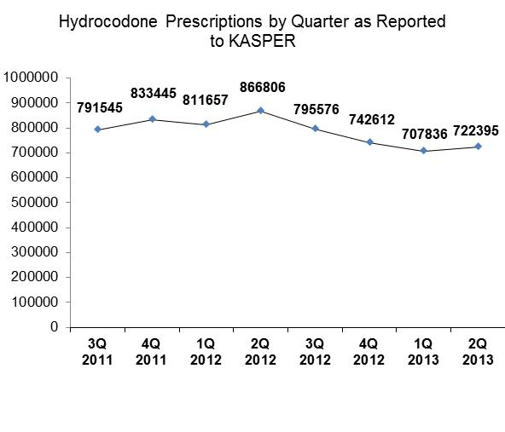
Hydrocodone

Slide 34
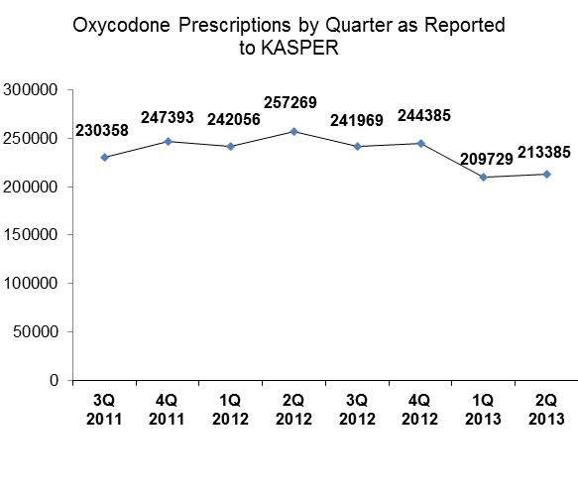
Oxycodone

Slide 35
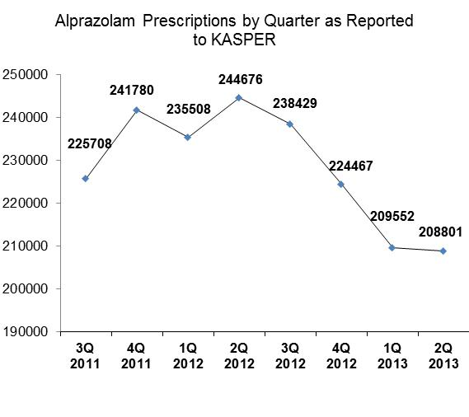
Alprazolam

Slide 36
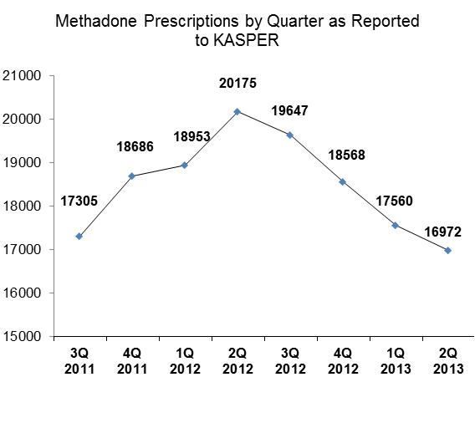
Methadone

Slide 37
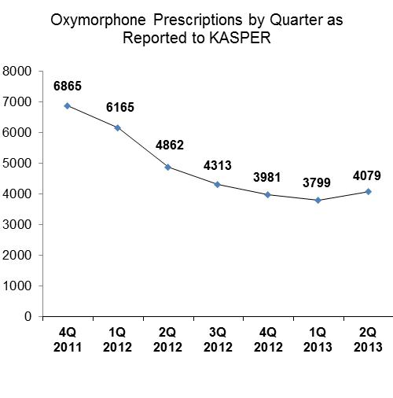
Oxymorphone

Slide 38
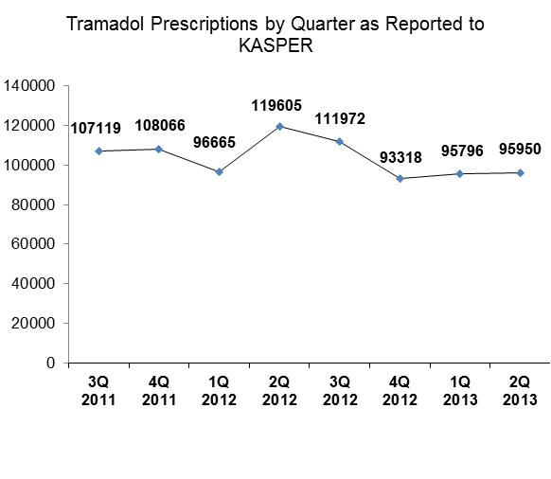
Tramadol

Slide 39
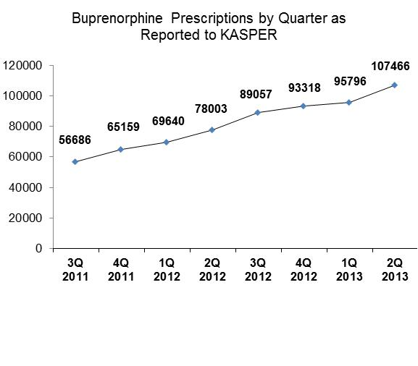
Buprenorphine

Slide 40
QUESTIONS?
Jill E. Lee
Kentucky Cabinet for Health and Family Services
275 East Main Street, 5ED
Frankfort, KY 40621
502-564-2815 ext. 3356
JillE.Lee@ky.gov
KASPER Web Site: www.chfs.ky.gov/KASPER

