Slide 1
Greg L. Jones, MD
Medical Director
Kentucky Physicians Health Foundation
How to Recognize Drug Abuse and Dependence in Patients

Slide 2
Faculty Disclosure
Dr. Jones has no financial relationships to disclose
Dr. Jones is a full time employee of the Kentucky Physicians Health Foundation
Dr. Jones will not be speaking about “off label” uses of drugs or devices

Slide 3
Educational Need/Practice Gap
Addiction is a common disease. It is frequently diagnosed late in the course or not at all. A high index of suspicion is necessary. It carries much misunderstanding and stigma as well.
Reduction of the stigma is needed. Better screening and early referral for specialized treatment are also needed.

Slide 4
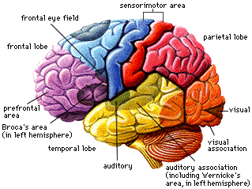
Addiction is a brain disease, not a symptom secondary to a psychiatric disorder
Reward Pathway
Median Forebrain
Nucleus Accumbens
Ventral Tegmentum
Dopamine

Slide 5
Addiction- Is it NATURE OR Nurture? Yes

Slide 6
The Primary Risk Factors for Addiction
Inheritance
Age of first use
Availability of addictive substances

Slide 7
Who’s at risk?
A first degree relative -4 x risk of Addiction
Use of an addictive substance before age 15 -5 x risk
Some develop Addiction without either
Approximately 15% of population

Slide 9
Primary Drugs of Addiction
Alcohol
Opiates
Benzodiazepines/ Z-drugs -All Sedative/Hypnotics
Cannabis
Cocaine
Amphetamines (includes other stimulants like Ritalin)
(Tramadol, Pregabalin, Provigil…Coming on strong)

Slide 10
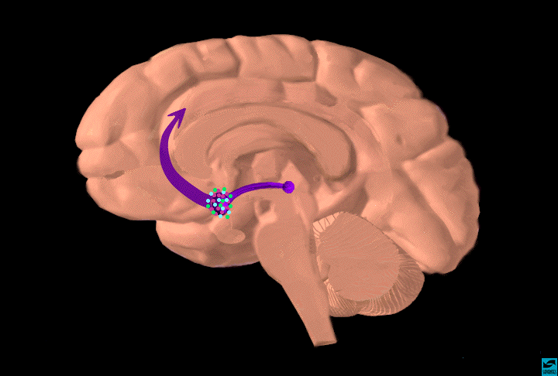
Dopamine Pathways – Pleasure pathways
striatum
frontal
cortex
hippocampus
alcohol
substantia
nigra/VTA
cocaine
heroin
nicotine
amphetamines
opiates
THC
PCP
ketamine
heroin
alcohol
benzodiazepines
barbiturates
nucleus
accumbens

Slide 11
Alcoholism / Drug Addiction
Not bad people, just people with a bad disease
A Chronic, Progressive and very unpleasant, on the way to being Fatal illness
An illness that is preventable and treatable

Slide 12
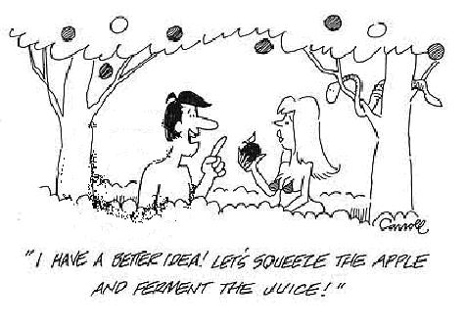

Slide 13
Center on Addiction and Substance Abuse at Columbia University-2005
17.5% is underage drinking
20.1% is adult problem drinking
Combined value to alcohol industry $48.3 billion or 37.5 % of revenues (50% of alcohol consumed by volume)

Slide 14
“At Risk Drinking”
A level of alcohol consumption that is directly harmful, or is correlated with a greater risk of health problems.
Men: > 14 drinks per week
5 or more drinks per occasion
Women: > 7 drinks per week
4 or more drinks per occasion

Slide 15
Lifetime Alcohol Dependence by Age of Onset of Drinking
AGE of Drinking Onset in YEARS
http://www.niaaa.nih.gov/about/budweb1.htm
Grant & Dawson, 1997

Slide 16
Notes:
Getting folks to take drugs is very big, very profitable business

Slide 17
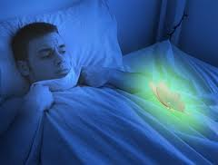
“Oh My God! There’s a radioactive moth in here!”

Slide 18
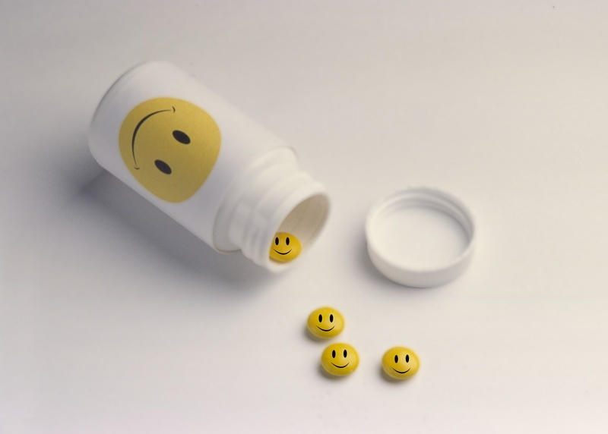
Opiates for All

Slide 19
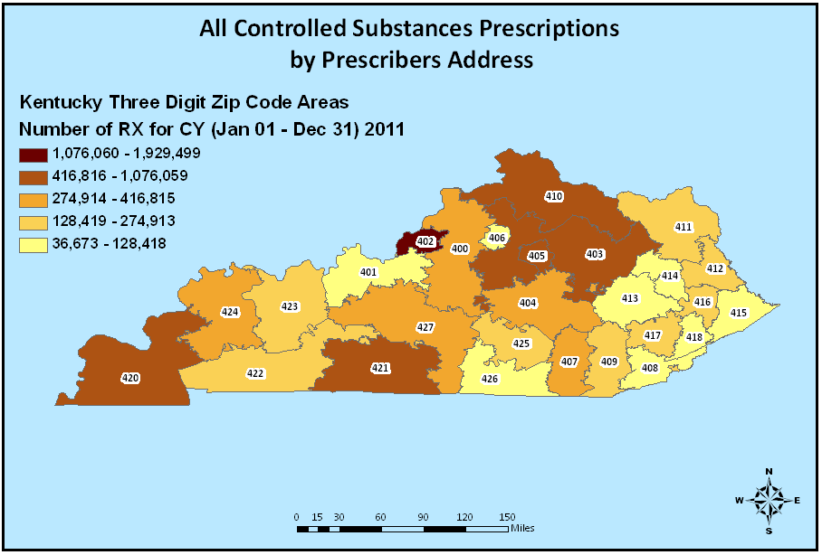
Controlled Substance Prescribing 2011

Slide 20
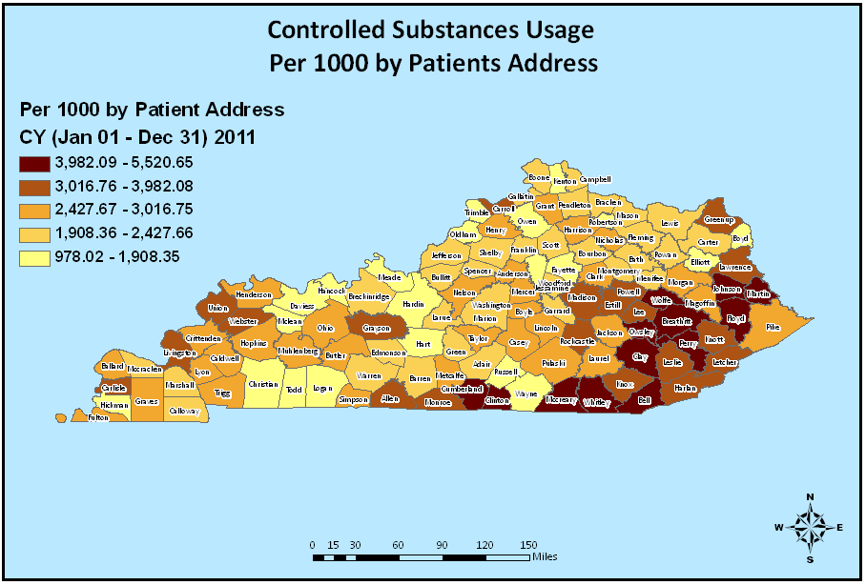
Controlled Substance Usage 2011

Slide 21
CAGE-AID: CAGE Questions Adapted to Include Other Drugs
Have you felt you ought to cut down on your drinking or drug use?
Have people annoyed you by criticizing your drinking or drug use?
Have you felt bad or guilty about your drinking or drug use?
Have you ever had a drink or used drugs first thing in the morning (eye opener)to steady your nerves, get rid of a hangover, or get the day started?

Slide 22
Screening I use
Do you recall how old you were when you first used alcohol or another drug?
Do you recall any of your family members having issues with alcohol or other drugs?

Slide 23
One Question Screening-Alcohol
“How many times in the past year have you had X or more drinks in a day?”
Where X is 5 for men
4 for women
One or more times is a positive screen
81.8% sensitive and 79.3% specific

Slide 24
One Question Screening-Drugs
“How many times in the past year have you used a drug to get high?”
One or more times is a positive screen

Slide 25
If screen is positive dig deeper
Screening is not diagnosing

Slide 26
How to tell who has this disease

Slide 27
DSM IV DEPENDENCE
Tolerance
Withdrawal
Using more than intended or more often
Persistent desire to cut back
Lots of time using or recovering
Decreased function: social/occupational/recreational
Continued use despite physical/psychological problems
Notes:
Textbook definition

Slide 28
My Diagnostic Criteria
Use of Alcohol or some other Addictive substance (Opiates, Sedatives, Amphetamines, Cocaine, Marijuana)
Problems occurring while using these or as a result of using
Continued Use of any Addictive substance after problems begin
Notes:
My definition

Slide 29
PRE-Treatment-
Ask the Questions
Assess the Risks
Provide Support and Feedback
Follow-Up
Referral

Slide 30
Treatment-
Residential
Detox- Not Tx, but often required to begin Tx
IOP
Recovery groups (AA, NA…)
Group therapy
Individual therapy
Medication Assistance
Sober living or Half-Way Houses

Slide 31
Thanks

